Slide 1

INNOVATIVE PROJECT
PROGRAMMING FUNDAMENTALS
BY:-- PIYUSH SHARMA DEVVART
2K20/B10/61 2k20/B10/17
Submitted to : Ms. Gull Kaur

Slide 2

VACCINE MANAGEMENT SYSTEM

Slide 3
INTRODUCTION
This management system is designed for a single hospital or covid ward. This is designed in c++. Talking about the features of the management .
Our system can do the following tasks:-
It has inbuilt login system with auto generated capture code which make it safer.We can add vaccinated people data as well as we can count number of vaccine left in the hospital
In this project we can search data of vaccinated people data on the basis of Aadhar number, also we can search on the bases of other sub categories like gender, age, profession and Home State.

Slide 4
Objective
Our code is written in C++ language and it is designed to keep track of vaccination records and the government can take this data and use this data to make stats how many people of this age, profession, etc. are vaccinated in a specific State.

Slide 5
Motivation
We got Motivation to make this system by seeing that many vaccine were discovered in many parts of the world and hospitals should maintain the record of vaccinated people. We code this program to make work of hospitals and govt. easy.

Slide 6
Softwares Used
1. Visual code Studio
2. Code Blocks
3. Google Chrome
4. OS: Windows 10

Slide 7
Language
C++

Slide 8
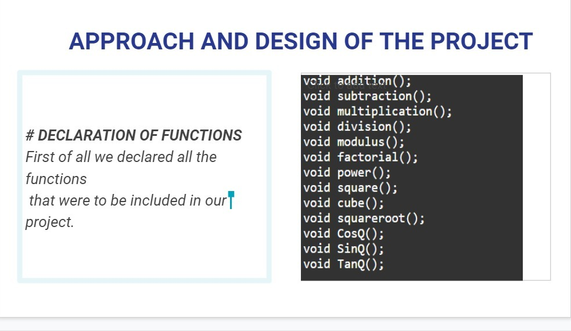
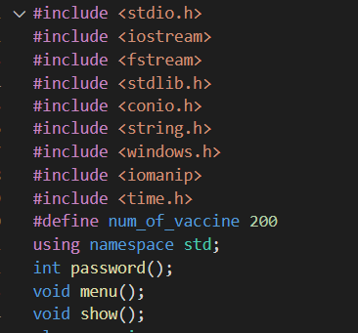
Approach
We have made a login system in which hospital admin will login. Then main menu will appear in which they can select

Slide 9
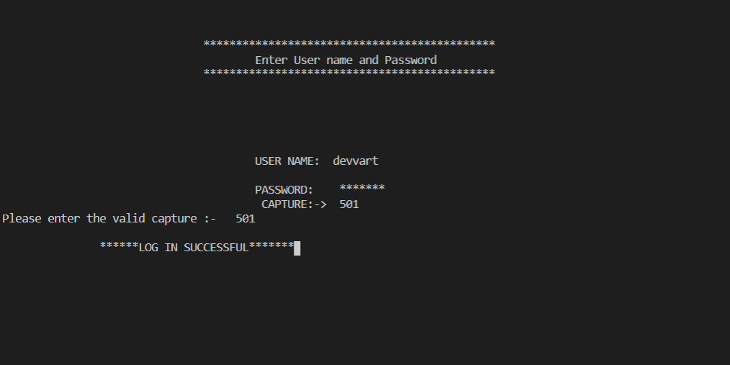
Login

Slide 10
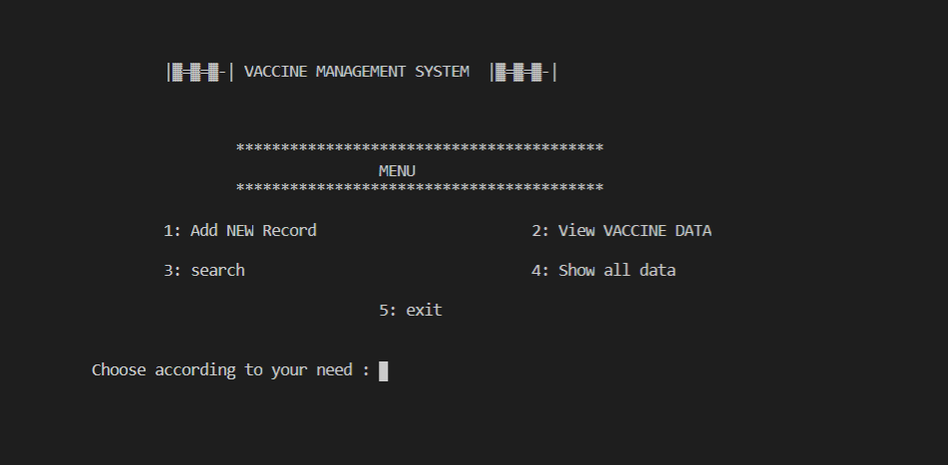
Main menu
#GIVING CHOICES TO THE USER
Now we have printed the list of all
choices from where user can choose
which task he has to perform.

Slide 11
HEADER FILES AND THEIR FUNCTIONS USED:-
IOSTREAM--cout, cin
STDIO.H--gets(),puts()
FSTREAM-read(), write(), seekg(),
CONIO.H--clrscr(), getch(),
STRING.H--strcpy(),strcmp(),compare(), strcmpi(),
WINDOWS.H-- Sleep()
IOMANIP--setiosflags(), setw(),
TIME.H-- time()
stdlib.h--rand(), srand()

Slide 12
For source Source code, click on the link given below
Source Code Link : Vaccine Management System

Slide 13
Outputs

Slide 14
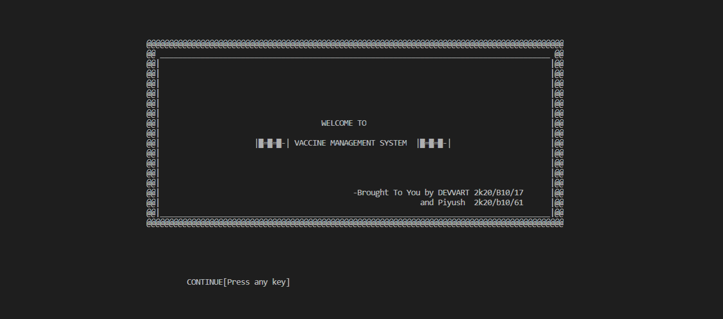
Welcome page
Press any key to continue

Slide 15
Login successfully

Slide 16
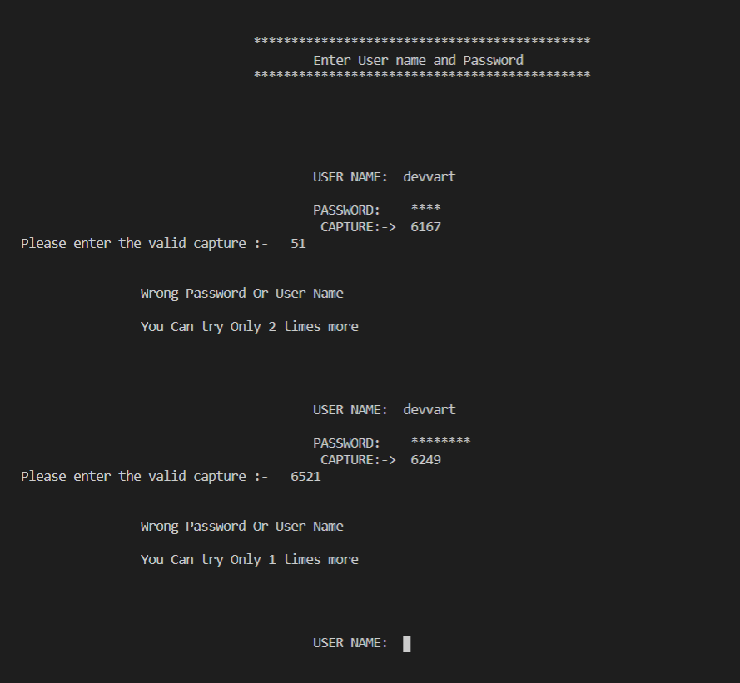
Login Failed

Slide 17
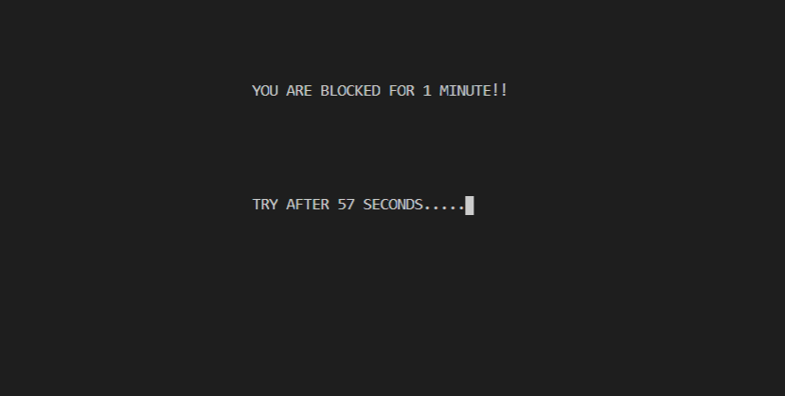
If user enter wrong credentials or capture code 3 times then system will be block for 1 minutes

Slide 18
Main menu

Slide 19
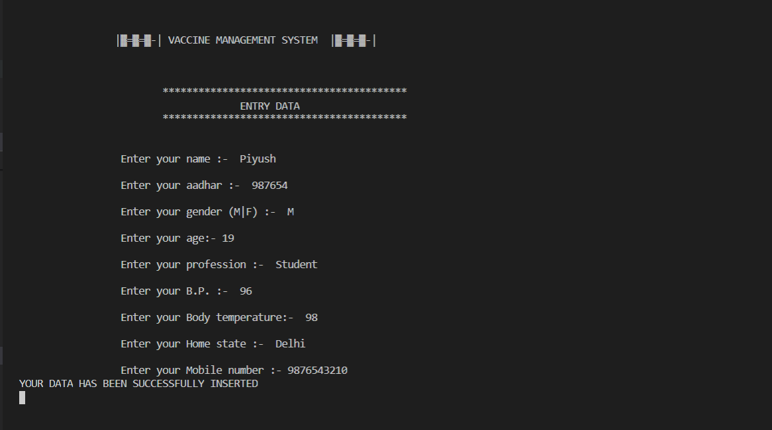
Entry Data

Slide 20
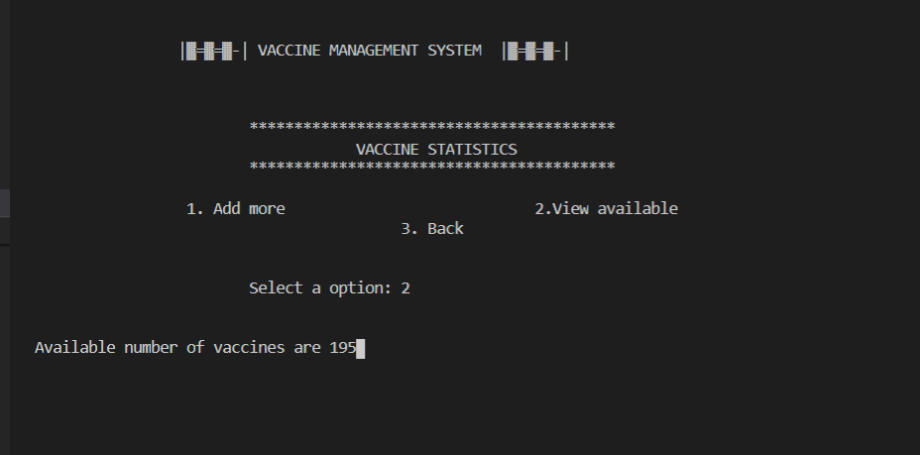
Vaccine Statistics

Slide 21
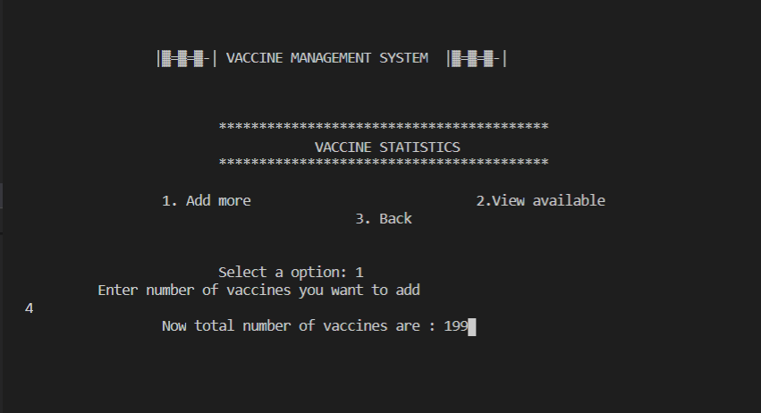
Adding more vaccines

Slide 22
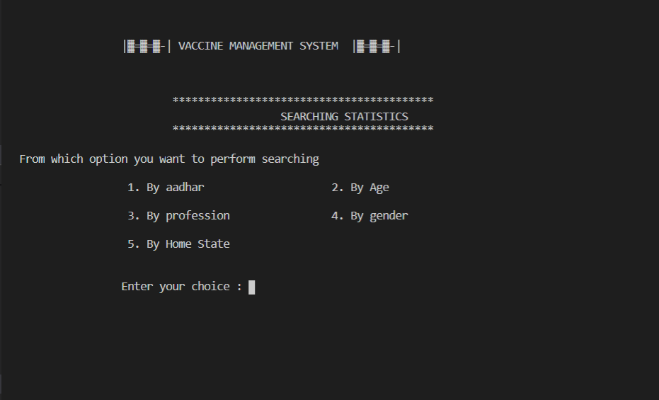
Searching Statictics

Slide 23
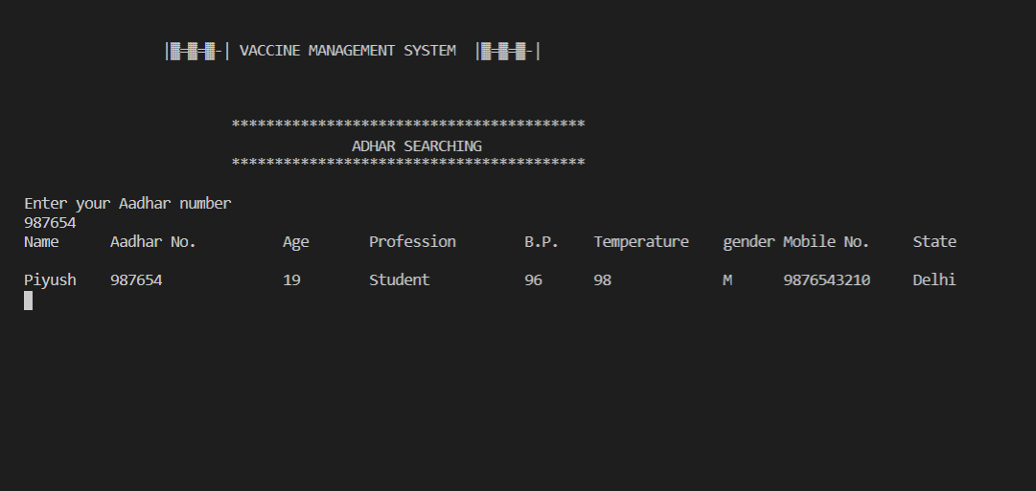
Searching(By Aadhar)

Slide 24
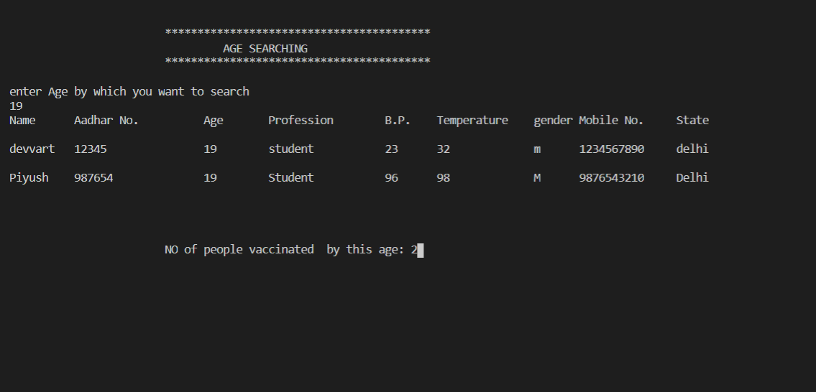
Searching(By Age)

Slide 25
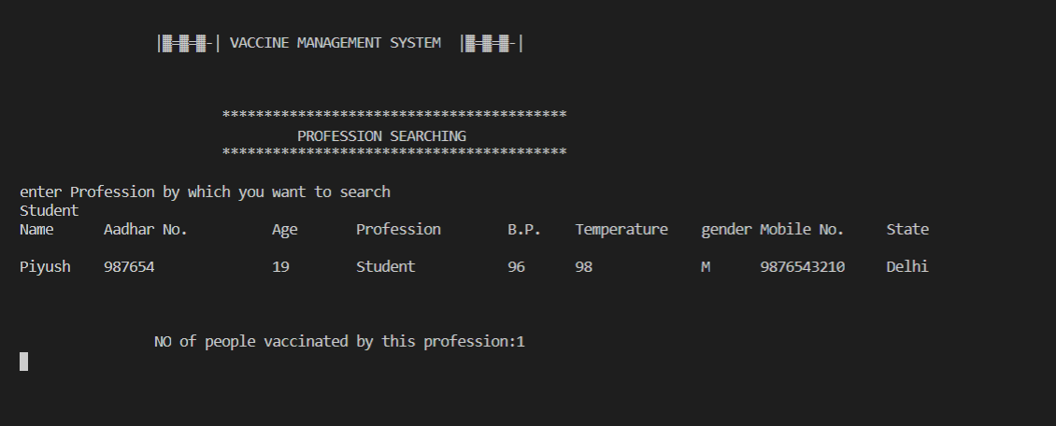
Searching(By profession)

Slide 26
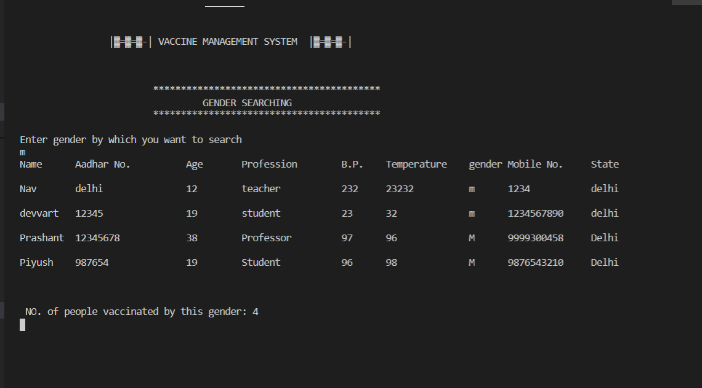
Searching(by gender)

Slide 27
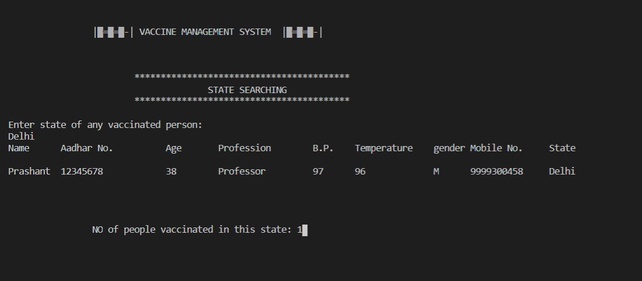
Searching(By State)

Slide 28
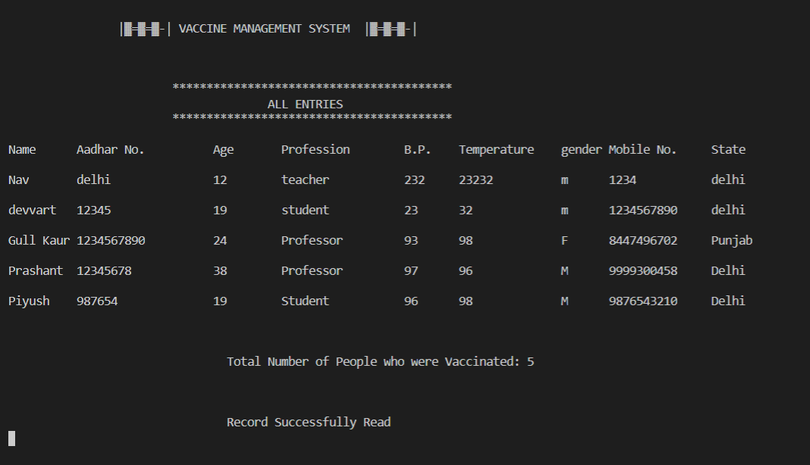
View all Data

Slide 29
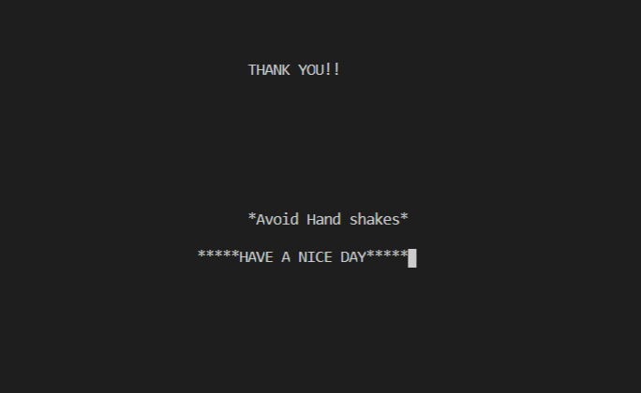
Exit

Slide 30
REFERENCE
1.GEEKS FOR GEEKS
2.STACK OVERFLOW
3.ONLINE STUDY MATERIAL

Slide 31
CONCLUSION:-
This project helps the user(Hospital admin) to keep track of vaccination process. Government can use this data to make stats how many people’s of this age , profession etc. are vaccinated. This will also help user to understand the concepts and functions in C++ language especially the oops concept.
This project also helps in improving the knowledge of the user to a certain extent and understand the benefits of C++.

Slide 32
THANK YOUHANK
OU

